Slide 1
Java Lecture 9

Slide 2
Object oriented Programming
Need:
Object oriented programming is a concept that was created because of the need to overcome the problems that were found with using structured programming techniques. While structured programming uses an approach which is top down, OOP uses an approach which is bottom up.
Object oriented programming has taken a completely different direction, and will place an emphasis on objects and information(data). With object oriented programming, a problem will be broken down into a number of units. These units are called objects. The foundation of OOP is the fact that it will place an emphasis on objects and classes.

Slide 3
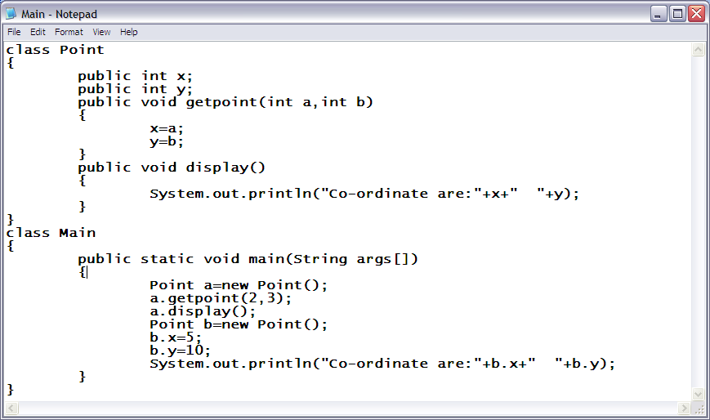
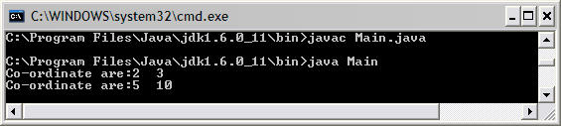
Object oriented Programming
Simple oops program example:-

Slide 4
Object oriented Programming
Object:-
  An object is an identifiable entity with some characteristics & behavior .E.g.. 1 Orange 2 chair
  characteristics
  1. It is spherical shape and color is orange
  2. It has four legs, back and arms
  behavior
  1. It is citrus in nature and taste sour
  2. It lets you sit on it
Class:-
  Class represents a set of objects that share common characteristics & behavior.
  A class is an object maker or object factory. Created objects are knows as instance of class.

Slide 5
Object oriented Programming
Before you can construct an object oriented system, you will first need to find the objects within the system and determine the relationships they have. This process is called data modeling.
Basic concept of OOP(object oriented programming)
  Abstraction refers to the act of representing essential features without including the background details or expressions.
  Encapsulation the wrapping of data and functions into a single unit (class) is known as encapsulation.
  Inheritance is the capability of one class of things to inherit capabilities and properties from another class.
  Polymorphism is the ability for a message or data to be processed in more than one form.(function/constructor overloading).
  The object is implemented in software term as follows.
  characteristics & Attributes are implemented through member variables or data items of the objects(data member)
  behavior is implemented through member function called methods/function.
  A method is an operation associated to an object.(member function)
  Behavior of an object is represented through associated function called methods.

Slide 6
Object oriented Programming
Example:-
There are three shapes square, triangle & circle . When user click on any shape it get rotated clockwise 360 degree and a sound is also played.
Two approach:
  Procedural approach:
    ”what are the things this program do”. ”what procedure do we need like rotate () and playsound()”.
  Object oriented approach:
    “what are the things in the program like shapes”.

Slide 7
Object oriented Programming
Access Modifier/specifier :-
public members are accessible everywhere in the program.
private members are accessible only inside their own class.
protected members are accessible inside their own class, sub class and package.
The default members are accessible inside their class as well to the classes in the same package. The default access specifier is not a keyword.

Slide 8
Object oriented Programming
Constructor
  A member function with the same name as its class is called constructor and it is used to initialize the objects of that class type with legal initial value. Constructors have no return type not even void.
  Parameterized constructor a constructor receiving arguments is known as parameterized constructor. It allow us to initialize the various data elements of different objects with different values when they are created. It also hides the default constructor.
  Non Parameterized constructor(default) if a class has no defined constructor the compiler will supply a default constructor it initializes the data members by any dummy value.
  Constructor overloading is also possible.
  this keyword is used to refer to currently calling object.

Slide 9
Object oriented Programming
Example:
    Define a class Complex with following specifications:
    Class Name Complex
    Data Members x-to store real part of the complex number y-to store imaginary part of the complex number
    MEMBER FUNCTIONS
    Complex(int nx ,int ny) constructor
    int isEqual(Complex z) returns 1,if z is equalto current complex number,0 otherwise
    Complex Add(Complex z) to add z to current complex number and return
    Complex Subtract(Complex z) to subtract z from current complex number and return
    void display() to display complex number in proper format

